Slide 1
L15. Reinforcement Learning
(Monte Carlo Methods)

Slide 2
Project
1. Define your own problem. It can be anything
2. Formulate the problem using mathematical expressions
3. Describe what type of data is required for the formulation
-describe how to obtain data
-describe how to process data
-describe how to build models that are required for your formulation
4. Discuss what types of decision making methods can be used to solve the
formulated problem
-list more than two methods and discuss their pros and cons
-discuss limitations in each method
5. Future Plan
Midterm 25%, Final 25%, Project 25%, HW 25% (5% each)
Format: Report (more than 2pages but less than 5 pages)
Evaluations: 25, 24, 23, 22, 21, 20 (Full score is 25)
Bonus points: up to 5 points

Slide 3


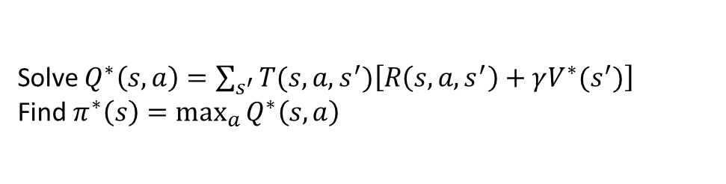
From MDP to Reinforcement Learning
Markov Decision Process (Offline)
Have mental model of how the world works
Find policy to collect the maximum rewards
Solve $Q_{ }^{∗}\left(s,a\right)=\sum_{s^{′}}{T(s,a,s^{′})\left[R\left(s,a,s^{′}\right)+γV^{∗}(s^{′})\right]}$
Find $π^{∗}\left(s\right)=\max_{a}{Q_{ }^{∗}\left(s,a\right)}$
Reinforcement Learning (Offline & Online)
Don’t know how the world works
Perform a sequence of actions in the world to maximize the rewards
$s_{1}, a_{1}, r_{1};s_{2}, a_{2}, r_{2}$; $s_{3}, a_{3}, r_{3}$; $…$; $s_{T}, a_{T}, r_{T}→Q_{ }^{∗}\left(s,a\right)→π^{∗}(s)$
Reinforcement learning is really the way humans work:
we go through life, taking various actions, getting feedback.
We get rewarded for doing well and learn along the way.

Slide 4


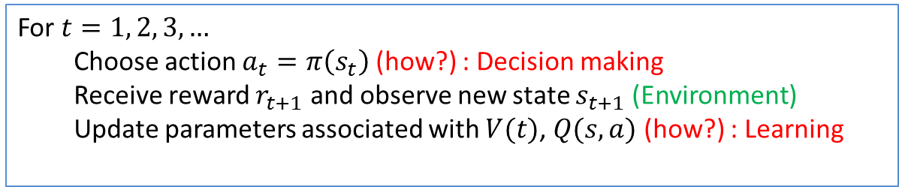

Reinforcement Learning Template
Agent
action $a$
Environment
or
Simulator
New state $s′$, reward $r$
$s_{1}, a_{1};r_{2},s_{2}, a_{2}$;$r_{3},s_{3}, a_{3}$; $…$;$r_{T},s_{T}$
Template for Reinforcement Learning
For $t=1, 2, 3,…$
Choose action $a_{t}=π\left(s_{t}\right)$ (how?) : Decision making
Receive reward $r_{t+1}$ and observe new state $s_{t+1}$ (Environment)
Update parameters associated with $V(t)$, $Q(s,a)$ (how?) : Learning

Slide 5
Road Map
Monte Carlo Method (Sutton & Barto Ch.5)
Model-Based Monte Carlo method
Model-free Monte Carlo method
Policy Evaluation
Policy Improvement
Policy Iteration (Monte Carlo control)
On-policy
Off-policy
Temporal Difference Learning (Sutton & Barto Ch.6)
SARSA
Q-Learning

Slide 6
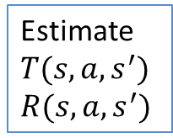
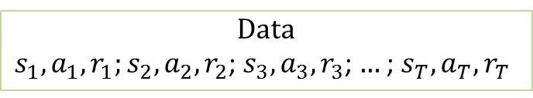

Road Map
Model-Based Reinforcement learning
Estimate
$T(s, a, s^{′})$
$$R(s, a, s^{′})$$
Data
$s_{1}, a_{1}, r_{1};s_{2}, a_{2}, r_{2}$; $s_{3}, a_{3}, r_{3}$; $…$; $s_{T}, a_{T}, r_{T}$
Solve
MDP
Model-FREE Reinforcement learning
How to estimate $V^{∗}(s)$ and $Q^{∗}(s,a)$
Monte Carlo method
Temporal Difference methods
Non-Bootstrap
Bootstrap
On-policy
On-policy
Monte Carlo Control
SARSA
How to
explore ?
Off-policy
Off-policy
Monte Carlo Control
Q-Learning
Episodic based
Single-data-point based

Slide 7
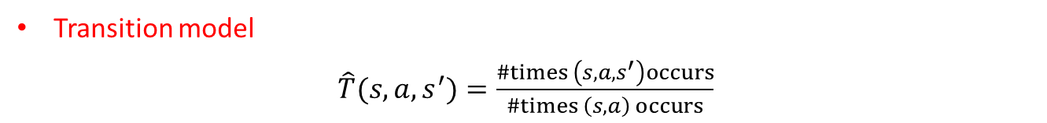
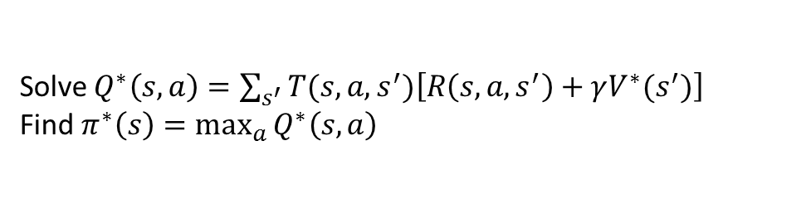
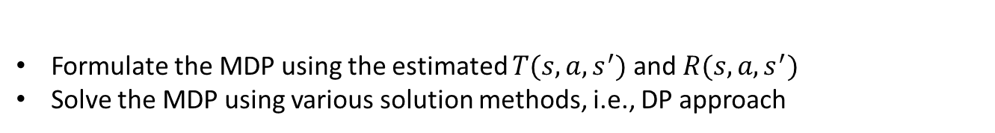


Model-Based Reinforcement Learning (Monte Carlo Methods)
Key Idea : model-based learning
Formulate the MDP using the estimated $T(s, a, s^{′})$ and $R(s, a, s^{′})$
Solve the MDP using various solution methods, i.e., DP approach
Solve $Q_{ }^{∗}\left(s,a\right)=\sum_{s^{′}}{T(s,a,s^{′})\left[R\left(s,a,s^{′}\right)+γV^{∗}(s^{′})\right]}$
Find $π^{∗}\left(s\right)=\max_{a}{Q_{ }^{∗}\left(s,a\right)}$
Data following policy $π$
$s_{1}, a_{1}, r_{1};s_{2}, a_{2}, r_{2}$; $s_{3}, a_{3}, r_{3}$; $…$; $s_{T}, a_{T}, r_{T}$
Transition model
$\hat{T}(s,a,s^{′})=\frac{\#times \left(s, a, s^{′}\right)occurs}{\#times \left(s, a\right) occurs}$
Reward model
$$\hat{R}\left(s,a,s^{′}\right)=\text{average} \text{of} r \text{in} \left(s, a,r,s′\right)$$

Slide 8


Model-Based Reinforcement Learning (Monte Carlo Methods)
Example
 | A
B | C | D
 | E
Input Policy π
Assume: γ = 1
Observed Episodes (Training)
Episode 1
Episode 2
Episode 3
Episode 4
B, east, C, -1
C, east, D, -1
D, exit, x, +10
B, east, C, -1
C, east, D, -1
D, exit, x, +10
E, north, C, -1
C, east, D, -1
D, exit, x, +10
E, north, C, -1
C, east, A, -1
A, exit, x, -10
Learned Model
$T(s, a, s^{′})$
$$R(s, a, s^{′})$$
T(B, east, C) = 1.00
T(C, east, D) = 0.75
T(C, east, A) = 0.25
R(B, east, C) = -1
R(C, east, D) = -1
R(D, exit, x) = +10

Slide 9
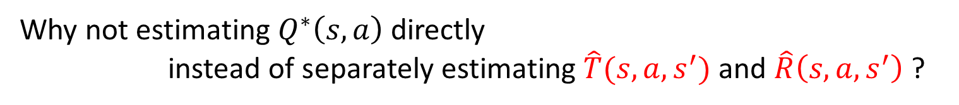
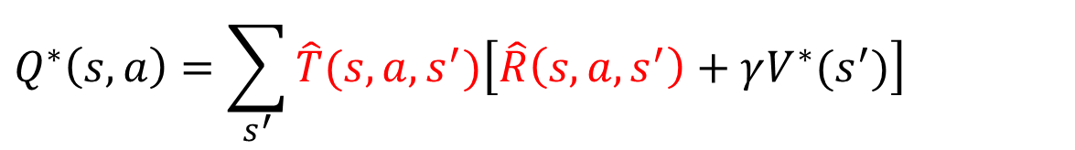

From Model-Based to Model Free
$$Q_{ }^{∗}\left(s,a\right)=\sum_{s^{′}}{\hat{T}(s,a,s^{′})\left[\hat{R}\left(s,a,s^{′}\right)+γV^{∗}(s^{′})\right]}$$
Estimation
Why not estimating $Q_{ }^{∗}\left(s,a\right)$ directly
instead of separately estimating $\hat{T}(s,a,s^{′})$ and $\hat{R}\left(s,a,s^{′}\right)$ ?
$$π^{∗}\left(s\right)=arg\max_{a}{Q^{∗}\left(s, a\right)}$$

Slide 10

Model-Free Monte Carlo Based Methods
How to estimate $V^{∗}(s)$ and $Q^{∗}(s,a)$
Monte Carlo method
Temporal Difference methods
Non-Bootstrap
Bootstrap
On-policy
On-policy
Monte Carlo Control
SARSA
How to
explore ?
Off-policy
Off-policy
Monte Carlo Control
Q-Learning
Episodic based
Single-data-point based

Slide 11
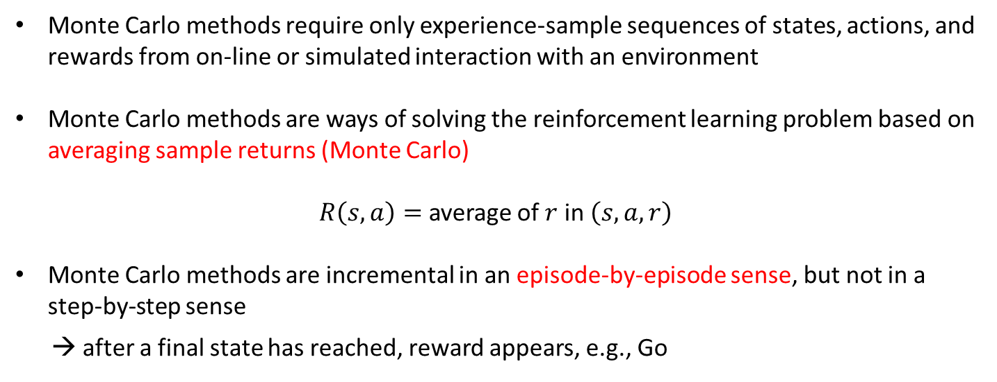
Model-Free Monte Carlo Based Methods
Monte Carlo methods require only experience-sample sequences of states, actions, and rewards from on-line or simulated interaction with an environment
Monte Carlo methods are ways of solving the reinforcement learning problem based on averaging sample returns (Monte Carlo)
$R\left(s, a\right)=$ average of $r$ in $\left(s, a,r\right)$
Monte Carlo methods are incremental in an episode-by-episode sense, but not in a step-by-step sense
→ after a final state has reached, reward appears, e.g., Go
Dynamic Programming
Monte Carlo Methods
Policy Evaluation
Policy Iteration
Policy Improvement
Policy Evaluation
Policy Iteration
Policy Improvement
Key ideas

Slide 12
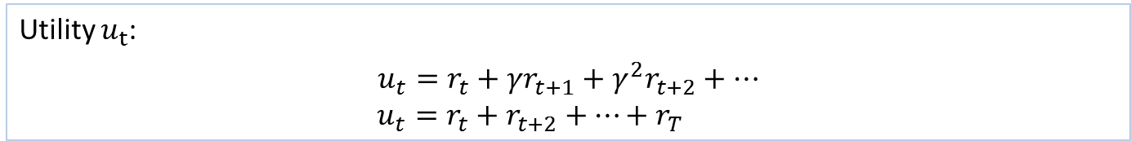
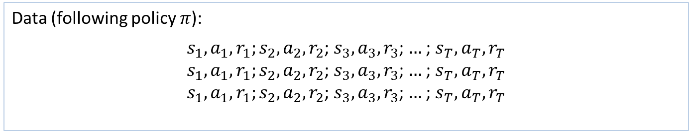

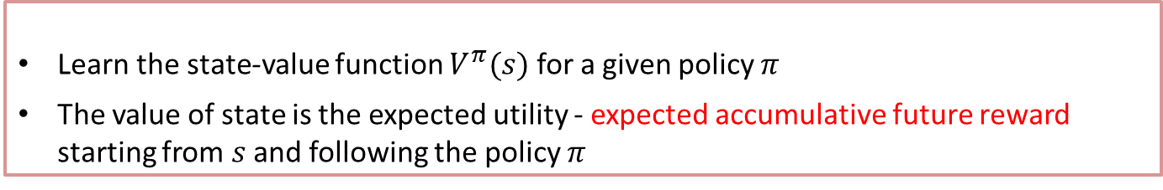

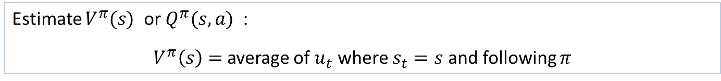
Monte Carlo Policy Evaluation
Key Idea : Monte Carlo Policy Evaluation
Learn the state-value function $V^{π}(s)$ for a given policy $π$
The value of state is the expected utility - expected accumulative future reward starting from $s$ and following the policy $π$
Data (following policy $π$):
$s_{1}, a_{1}, r_{1};s_{2}, a_{2}, r_{2}$; $s_{3}, a_{3}, r_{3}$; $…$; $s_{T}, a_{T}, r_{T}$
$s_{1}, a_{1}, r_{1};s_{2}, a_{2}, r_{2}$; $s_{3}, a_{3}, r_{3}$; $…$; $s_{T}, a_{T}, r_{T}$
$s_{1}, a_{1}, r_{1};s_{2}, a_{2}, r_{2}$; $s_{3}, a_{3}, r_{3}$; $…$; $s_{T}, a_{T}, r_{T}$
$s_{t}∈𝒮=\left\{s^{1},s^{2},s^{3}\right\}$,$a_{t}∈𝒜=\left\{a^{1},a^{2},a^{3}\right\}$
Episode 1:
Episode 2:
Episode 3:
$$⋮$$
Utility $u_{t}$:
$$u_{t}=r_{t}+γr_{t+1}+γ^{2}r_{t+2}+…$$
$u_{t}=r_{t}+r_{t+2}+…+r_{T}$
Estimate $V^{π}(s)$ or $Q^{π}(s,a)$ :
$V^{π}\left(s\right)=$ average of $u_{t}$ where $s_{t}=s$ and following $π$
Because the value being computed is dependent on the policy used to generate the data, we call this an on-policy algorithm.

Slide 13





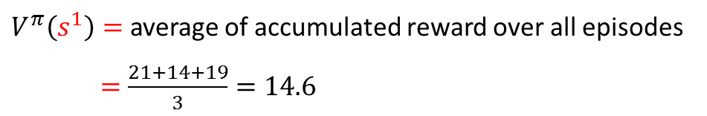


Monte Carlo Policy Evaluation
Key Idea : Monte Carlo Policy Evaluation
Learn the state-value function $V^{π}(s)$ for a given policy $π$
The value of state is the expected utility - expected accumulative future reward starting from $s$ and following the policy $π$
$s_{t}∈𝒮=\left\{s^{1},s^{2},s^{3}\right\}$,${ a}_{t}∈𝒜=\left\{a^{1},a^{2},a^{3}\right\}$
$\left(State,Action,Reward \right)$ pairs generated by policy $π$
$(s^{1}, a^{2}, 1);(s^{3}, a^{1}, 5)$; $\left(s^{2}, a^{3}, 3\right),(s^{1}, a^{3}, 10)$, $\left(s^{2}, a^{2}, 2\right)$
$(s^{3}, a^{1}, 5)$; $\left(s^{2}, a^{2}, 2\right);\left(s^{1}, a^{2}, 1\right);\left(s^{2}, a^{3}, 3\right),(s^{1}, a^{3}, 10)$
$\left(s^{2}, a^{3}, 3\right);(s^{1}, a^{2}, 1);(s^{3}, a^{1}, 5)$;$(s^{1}, a^{3}, 10)$, $\left(s^{2}, a^{2}, 2\right)$
Episode 1:
Episode 2:
Episode 3:
$$(γ=1)$$
Episode 1:
$V^{π}\left(s^{1}\right)=1+5+3+10+2=21$
Episode 2:
$$V^{π}\left(s^{1}\right)=1+3+10=14$$
First visit to $s$
Episode 3:
$$V^{π}\left(s^{1}\right)=1+5+10+2=19$$
$V^{π}\left(s^{1}\right)=$ average of accumulated reward over all episodes
$=$ $\frac{21+14+19}{3}=14.6$

Slide 14


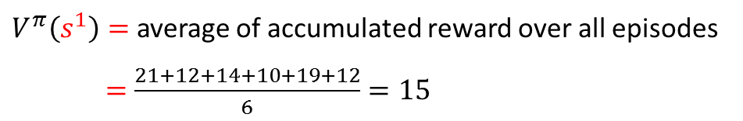
Monte Carlo Policy Evaluation
Key Idea : Monte Carlo Policy Evaluation
Learn the state-value function $V^{π}(s)$ for a given policy $π$
The value of state is the expected utility - expected accumulative future reward starting from $s$ and following the policy $π$
$s_{t}∈𝒮=\left\{s^{1},s^{2},s^{3}\right\}$,${ a}_{t}∈𝒜=\left\{a^{1},a^{2},a^{3}\right\}$
$\left(State,Action,Reward \right)$ pairs generated by policy $π$
$(s^{1}, a^{2}, 1);(s^{3}, a^{1}, 5)$; $\left(s^{2}, a^{3}, 3\right),(s^{1}, a^{3}, 10)$, $\left(s^{2}, a^{2}, 2\right)$
$(s^{3}, a^{1}, 5)$; $\left(s^{2}, a^{2}, 2\right);\left(s^{1}, a^{2}, 1\right);\left(s^{2}, a^{3}, 3\right),(s^{1}, a^{3}, 10)$
$\left(s^{2}, a^{3}, 3\right);(s^{1}, a^{2}, 1);(s^{3}, a^{1}, 5)$;$(s^{1}, a^{3}, 10)$, $\left(s^{2}, a^{2}, 2\right)$
Episode 1:
Episode 2:
Episode 3:
$$(γ=1)$$
Episode 1:
$V^{π}\left(s^{1}\right)=1+5+3+10+2=21$; $V^{π}\left(s^{1}\right)=10+2=12$
Episode 2:
$$V^{π}\left(s^{1}\right)=1+3+10=14; V^{π}\left(s^{1}\right)=10=10$$
Every visit to $s$
Episode 3:
$$V^{π}\left(s^{1}\right)=1+5+10+2=19; V^{π}\left(s^{1}\right)=10+2=12$$
$V^{π}\left(s^{1}\right)=$ average of accumulated reward over all episodes
$=$ $\frac{21+12+14+10+19+12}{6}=15$

Slide 15
Monte Carlo Policy Evaluation
Example
Input Policy π
Observed Episodes (Training)
Output Values
Episode 1
Episode 2
-10
 | A
B | C | D
 | E
B, east, C, -1
C, east, D, -1
D, exit, x, +10
B, east, C, -1
C, east, D, -1
D, exit, x, +10
 | A
B | C | D
 | E
+8
+4
+10
Episode 3
Episode 4
-2
E, north, C, -1
C, east, D, -1
D, exit, x, +10
E, north, C, -1
C, east, A, -1
A, exit, x, -10
Assume: γ = 1

Slide 16
Monte Carlo Policy Evaluation
Example
What’s good about direct evaluation?
It’s easy to understand
It doesn’t require any knowledge of T, R
It eventually computes the correct average values, using just sample transitions
What bad about it?
It wastes information about state connections
Each state must be learned separately
So, it takes a long time to learn
Output Values
 | A
B | C | D
 | E
-10
+8
+4
+10
-2

Slide 17
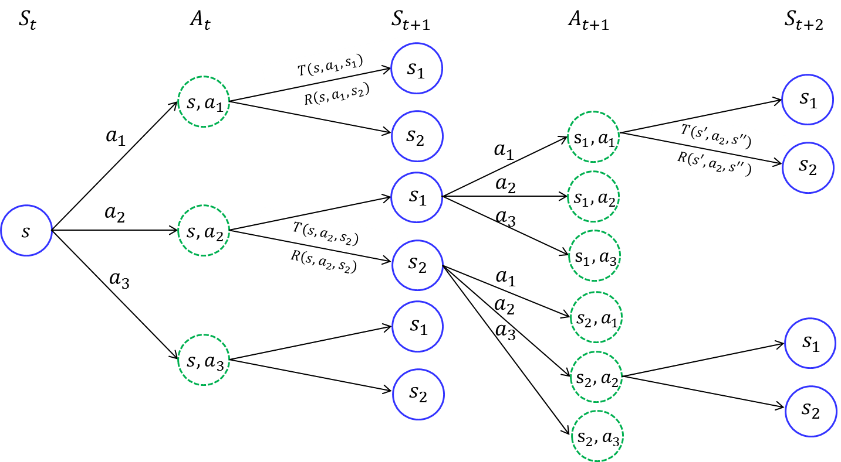
Monte Carlo Policy Evaluation

Slide 18
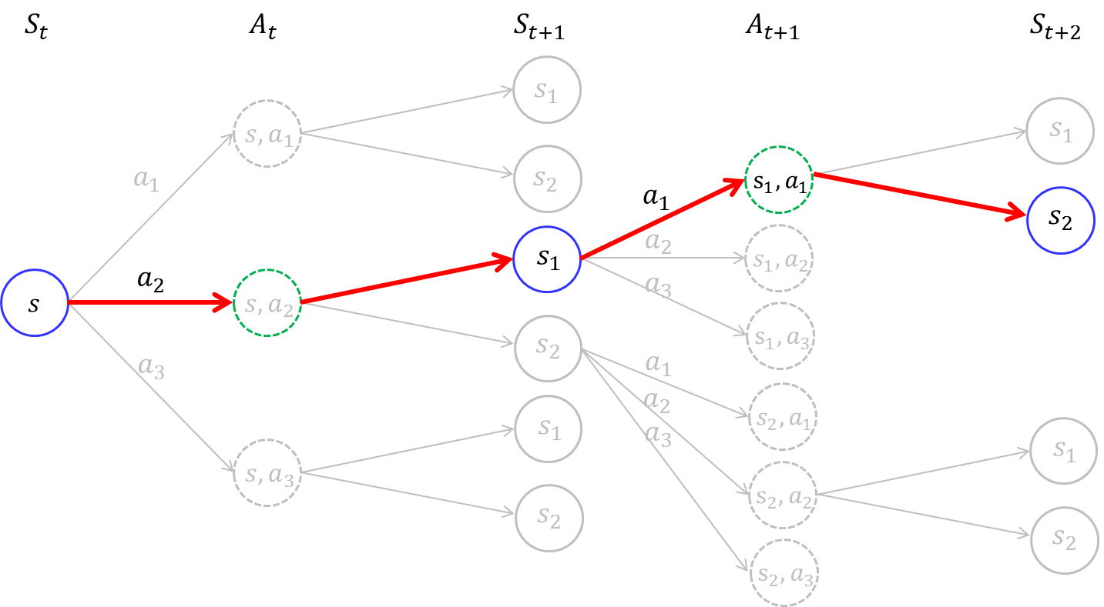
Monte Carlo Policy Evaluation
Estimates for each state are independent
The estimate for one state does not build upon the estimate of any other state
(No bootstrap)
The computational expense of estimating the value of a single state is independent of the number of states
Attractive when one requires the value of only a subset of the states

Slide 19
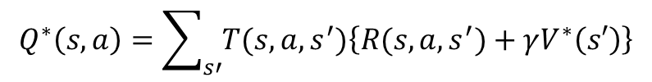
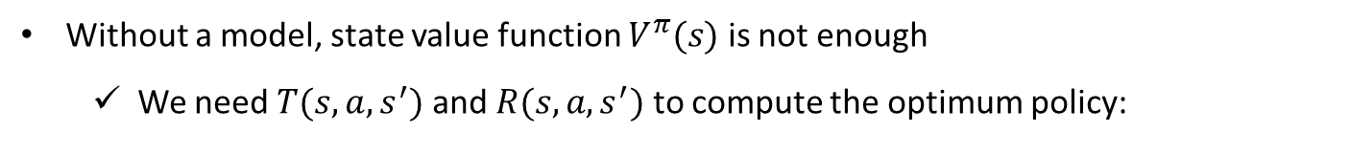

Monte Carlo Estimation of Action Values
Without a model, state value function $V^{π}(s)$ is not enough
We need $T(s,a,s^{′})$ and $R(s,a,s^{′})$ to compute the optimum policy:
$$Q^{∗}\left(s,a\right)=\sum_{s′}{T(s,a,s^{′})\left\{R(s,a,s^{′})+γV^{∗}\left(s′\right)\right\}}$$
$$a^{∗}=π^{∗}\left(s\right)=\underset{a∈𝒜(s)}{argmax}{Q^{∗}\left(s,a\right)}$$
One of primary goals for Monte Carlo method is to estimate $Q^{∗}\left(s,a\right)$

Slide 20
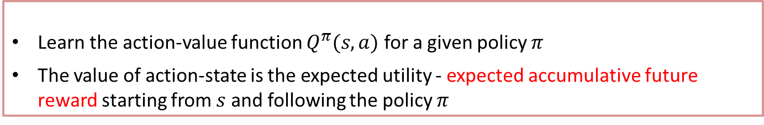

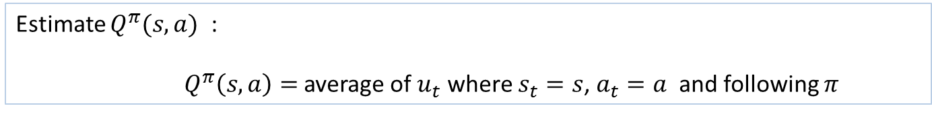



Monte Carlo Estimation of Action Values
Key Idea : Monte Carlo Policy Evaluation
Learn the action-value function $Q^{π}(s,a)$ for a given policy $π$
The value of action-state is the expected utility - expected accumulative future reward starting from $s$ and following the policy $π$
Data (following policy $π$):
$s_{1}, a_{1}, r_{1};s_{2}, a_{2}, r_{2}$; $s_{3}, a_{3}, r_{3}$; $…$; $s_{T}, a_{T}, r_{T}$
$s_{1}, a_{1}, r_{1};s_{2}, a_{2}, r_{2}$; $s_{3}, a_{3}, r_{3}$; $…$; $s_{T}, a_{T}, r_{T}$
$s_{1}, a_{1}, r_{1};s_{2}, a_{2}, r_{2}$; $s_{3}, a_{3}, r_{3}$; $…$; $s_{T}, a_{T}, r_{T}$
$s_{t}∈𝒮=\left\{s^{1},s^{2},s^{3}\right\}$,$a_{t}∈𝒜=\left\{a^{1},a^{2},a^{3}\right\}$
Episode 1:
Episode 2:
Episode 3:
$$⋮$$
Utility $u_{t}$:
$$u_{t}=r_{t}+γr_{t+1}+γ^{2}r_{t+2}+…$$
$u_{t}=r_{t}+r_{t+2}+…+r_{T}$
Estimate $Q^{π}(s,a)$ :
$Q^{π}\left(s,a\right)=$ average of $u_{t}$ where $s_{t}=s$, $a_{t}=a$ and following $π$

Slide 21




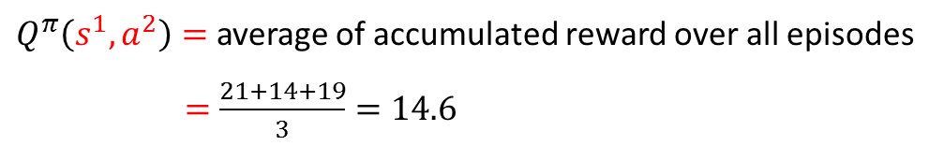
Monte Carlo Policy Evaluation
Key Idea : Monte Carlo Policy Evaluation
Learn the state-value function $Q^{π}(s,a)$ for a given policy $π$
The value of action-state is the expected utility - expected accumulative future reward starting from $s$ and following the policy $π$
$s_{t}∈𝒮=\left\{s^{1},s^{2},s^{3}\right\}$,${ a}_{t}∈𝒜=\left\{a^{1},a^{2},a^{3}\right\}$
$\left(State,Action,Reward \right)$ pairs generated by policy $π$
$(s^{1}, a^{2}, 1);(s^{3}, a^{1}, 5)$; $\left(s^{2}, a^{3}, 3\right),(s^{1}, a^{3}, 10)$, $\left(s^{2}, a^{2}, 2\right)$
$(s^{1}, a^{1}, 5)$; $\left(s^{2}, a^{2}, 2\right);\left(s^{1}, a^{2}, 1\right);\left(s^{2}, a^{3}, 3\right),(s^{1}, a^{3}, 10)$
$\left(s^{2}, a^{3}, 3\right);(s^{1}, a^{2}, 1);(s^{3}, a^{1}, 5)$;$(s^{1}, a^{3}, 10)$, $\left(s^{2}, a^{2}, 2\right)$
Episode 1:
Episode 2:
Episode 3:
$$(γ=1)$$
Episode 1:
$Q^{π}\left(s^{1},a^{2}\right)=1+5+3+10+2=21$
Episode 2:
$$Q^{π}\left(s^{1},a^{2}\right)=1+3+10=14$$
First visit to $s$
Episode 3:
$$Q^{π}\left(s^{1},a^{2}\right)=1+5+10+2=19$$
$Q^{π}\left(s^{1},a^{2}\right)=$ average of accumulated reward over all episodes
$=$ $\frac{21+14+19}{3}=14.6$

Slide 22

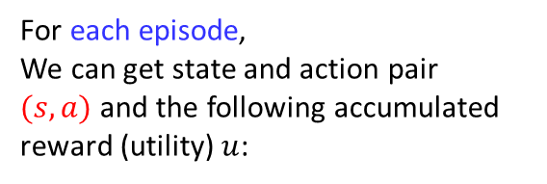


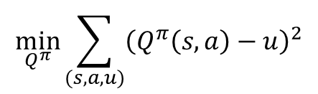
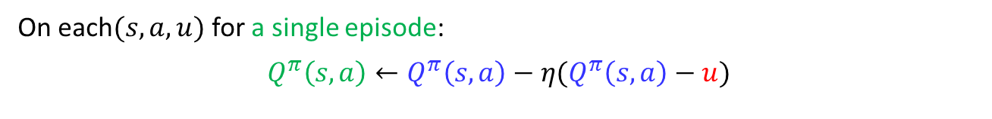
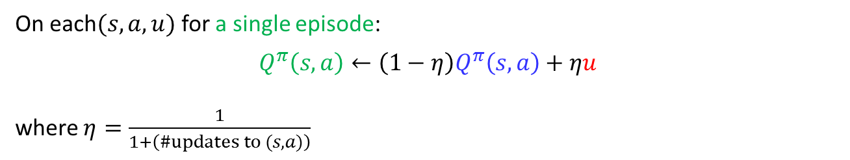
Incremental Formulation
$s_{1}, a_{1}, r_{1};s_{2}=s, a_{2}=a, r_{2}$; $s_{3}, a_{3}, r_{3}$; $…$; $s_{T}, a_{T}, r_{T}$
Episode 1
For each episode,
We can get state and action pair
$(s,a)$ and the following accumulated reward (utility) $u$:
$s_{1}=s, a_{1}=a, r_{1};s_{2}, a_{2}, r_{2}$; $s_{3}, a_{3}, r_{3}$; $…$; $s_{T}, a_{T}, r_{T}$
Episode 2
$s_{1}, a_{1}, r_{1};s_{2}, a_{2}, r_{2}$; $s_{3}=s, a_{3}=a, r_{3}$; $…$; $s_{T}, a_{T}, r_{T}$
Episode 3
$$⋮$$
$$\left(s,a\right)→u$$
$s_{1}, a_{1}, r_{1};s_{2},=s a_{2}=a, r_{2}$; $s_{3}, a_{3}, r_{3}$; $…$; $s_{T}, a_{T}, r_{T}$
Episode $∞$
Incremental formulation (convex combination):
On each$(s,a,u)$ for a single episode:
$$Q^{π}\left(s,a\right)←\left(1−η\right)Q^{π}\left(s,a\right)+ηu$$
where $η=\frac{1}{1+\left(\#updates to (s,a)\right)}$
Current estimate
New data
Stochastic gradient form :
On each$(s,a,u)$ for a single episode:
$$Q^{π}\left(s,a\right)←Q^{π}\left(s,a\right)−η(Q^{π}\left(s,a\right)−u)$$
The incremental formulations can be though of as a way to solve the following least square estimation in an online manner
$$\min_{Q^{π}}{\sum_{(s,a,u)}^{ }{{\left(Q^{π}\left(s,a\right)−u\right)}^{2}}}$$

Slide 23
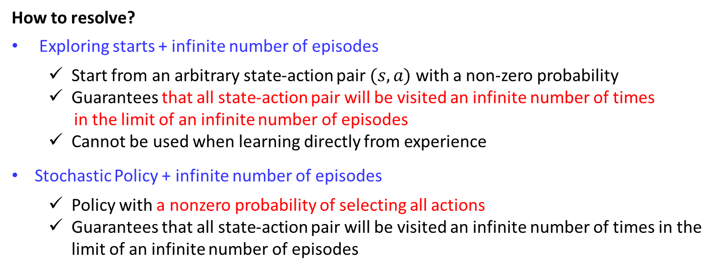
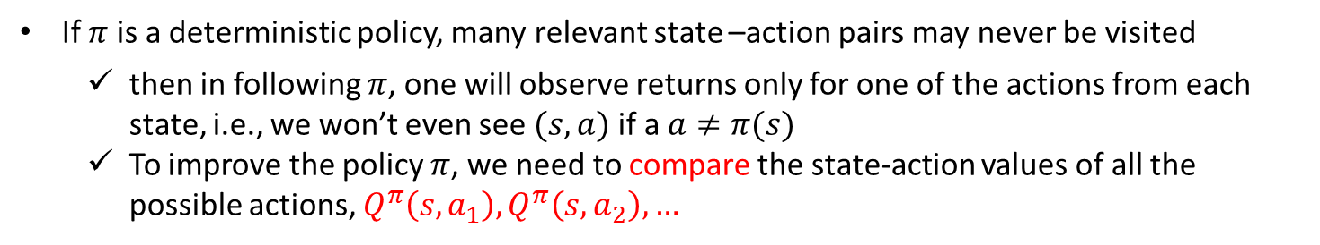
Issue of computing $Q^{π}\left(s,a\right)$
If $π$ is a deterministic policy, many relevant state –action pairs may never be visited
then in following $π$, one will observe returns only for one of the actions from each state, i.e., we won’t even see $(s,a)$if a $a≠π(s)$
To improve the policy $π$, we need to compare the state-action values of all the possible actions, $Q^{π}\left(s,a_{1}\right),Q^{π}\left(s,a_{2}\right), …$
To estimate $Q^{π}\left(s,a\right)$ reliably, we need a large number of episodes
Infinite number of episodes are required for accurate estimations
How to resolve?
Exploring starts + infinite number of episodes
Start from an arbitrary state-action pair $(s,a)$ with a non-zero probability
Guarantees that all state-action pair will be visited an infinite number of times
in the limit of an infinite number of episodes
Cannot be used when learning directly from experience
Stochastic Policy + infinite number of episodes
Policy with a nonzero probability of selecting all actions
Guarantees that all state-action pair will be visited an infinite number of times in the limit of an infinite number of episodes
We need an efficient exploration strategy!

Slide 24











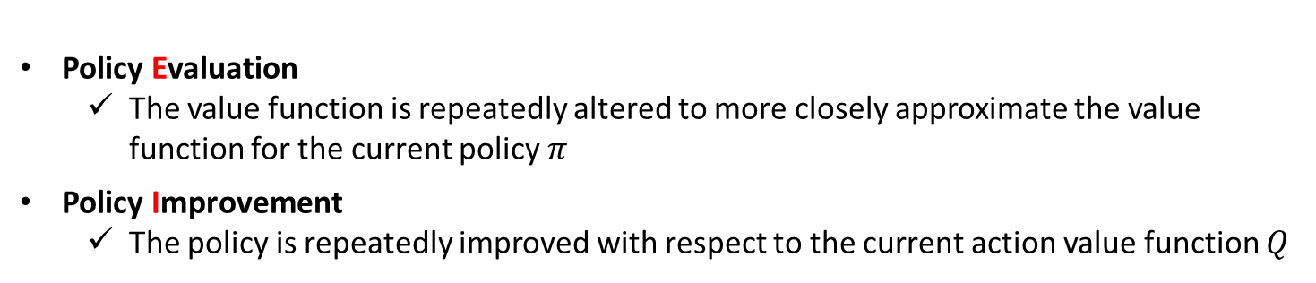

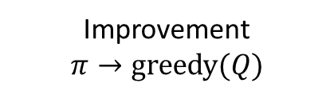






Monte Carlo Control
Key Idea : Monte Carlo Control
Idea of generalized policy iteration (GPI)
Monte Carlo Policy Evaluation + Policy improvement
Evaluation
$$Q→Q^{π}$$
$$π$$
$$Q$$
Improvement
$$π→greedy(Q)$$
- Infinite number of episodes
- Exploring starts
$$E$$
$$I$$
$$E$$
$$I$$
$$E$$
$$I$$
$$E$$
$$π_{0}$$
$$Q^{π_{0}}$$
$$π_{1}$$
$$Q^{π_{1}}$$
$$π_{2}$$
$$…$$
$$π_{∗}$$
$$Q^{∗}$$
Policy Evaluation
The value function is repeatedly altered to more closely approximate the value function for the current policy $π$
Policy Improvement
The policy is repeatedly improved with respect to the current action value function $Q$

Slide 25
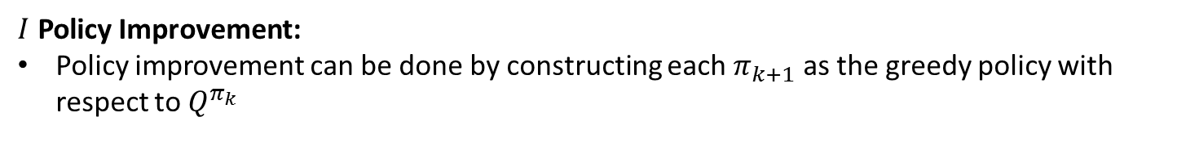


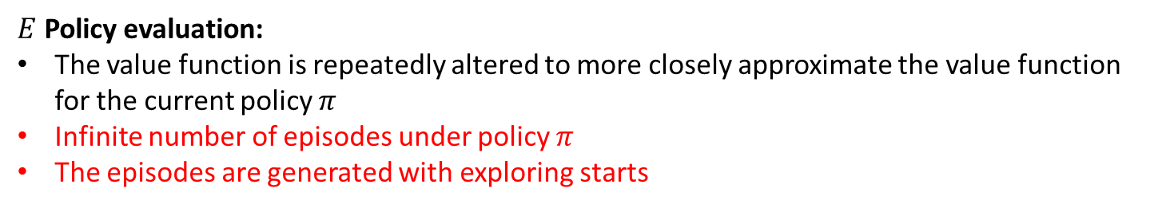



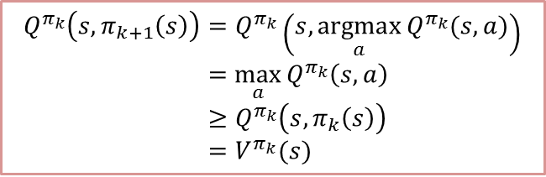


Monte Carlo Control
$E$ Policy evaluation:
The value function is repeatedly altered to more closely approximate the value function for the current policy $π$
Infinite number of episodes under policy $π$
The episodes are generated with exploring starts
Converge to exact $Q^{π}(s,a)$
$s_{1}, a_{1}, r_{1};s_{2}, a_{2}, r_{2}$; $s_{3}, a_{3}, r_{3}$; $…$; $s_{T}, a_{T}, r_{T}→u$
Episode 1
$s_{1}, a_{1}, r_{1};s_{2}, a_{2}, r_{2}$; $s_{3}, a_{3}, r_{3}$; $…$; $s_{T}, a_{T}, r_{T}→u$
Episode 2
exploring starts
$s_{1}, a_{1}, r_{1};s_{2}, a_{2}, r_{2}$; $s_{3}, a_{3}, r_{3}$; $…$; $s_{T}, a_{T}, r_{T}→u$
Episode 3
$$⋮$$
$s_{1}, a_{1}, r_{1};s_{2}, a_{2}, r_{2}$; $s_{3}, a_{3}, r_{3}$; $…$; $s_{T}, a_{T}, r_{T}→u$
Episode $∞$
Average expected reward
$I$ Policy Improvement:
Policy improvement can be done by constructing each $π_{k+1}$ as the greedy policy with respect to $Q^{π_{k}}$
$$π_{k+1}\left(s\right)=\underset{a}{argmax}{Q^{π_{k}}(s,a)}$$
$$Q^{π_{k}}\left(s,π_{k+1}\left(s\right)\right)=Q^{π_{k}}\left(s,\underset{a}{argmax}{Q^{π_{k}}(s,a)}\right)$$
$$=\max_{a}{Q^{π_{k}}\left(s,a\right)}$$
$≥Q^{π_{k}}\left(s,π_{k}\left(s\right)\right)$
$=V^{π_{k}}(s)$
$V^{π_{k+1}}\left(s\right)≥V^{π_{k}}(s)$ for all $s$
(Policy improvement theorem)
Overall process converges to an optimal policy and the optimal value function

Slide 26





Make Monte Carlo Control Practical
Assumptions:
- Infinite number of episodes
- Exploring starts
Relax these two assumptions
$$E$$
$$I$$
$$π_{0}$$
$$Q^{π_{0}}$$
$$π_{1}$$
Relaxing “Infinite number of episodes”
Policy improvement with an early stop (Generalized policy improvement concept)
The “in place” version of value iteration
Relaxing “exploring starts”
Discussed later

Slide 27

Monte Carlo control algorithm assuming exploring starts
Algorithm : Monte Carlo ES Control
Initialize, for all $s∈S, a∈A(s)$
$Q\left(s, a\right)←$ arbitrary
$π(s)$ $←$ arbitrary
$$U\left(s, a\right)← \text{empty} \text{list}$$
Repeat forever:
Generate an episode using exploring starts and $π$
For each pair $\left(s,a\right)$ appearing in the episode:
$U$ $←$ utility following the first occurrence of $s,a$
Append $U$ to $U\left(s, a\right)$
$Q\left(s, a\right)←$ average($U\left(s, a\right)$)
(c) For each $s$ in the episode:
$π(s)$ $←\underset{a}{argmax}{Q(s,a)}$
Policy evaluation
Policy improvement
In an single episode, both Policy evaluation and policy improvement proceeds together

Slide 28
Make Monte Carlo Control Practical
Assumptions:
- Infinite number of episodes
- Exploring starts
Relax these two assumptions
$$E$$
$$I$$
$$π_{0}$$
$$Q^{π_{0}}$$
$$π_{1}$$
Relaxing “Infinite number of episodes”
Policy improvement with an early stop (Generalized policy improvement concept)
The “in place” version of value iteration
Relaxing “exploring starts”
The only general way to ensure that all actions are selected infinitely often is for the agent to continue to select them
On-policy methods
Off-policy methods

Slide 29


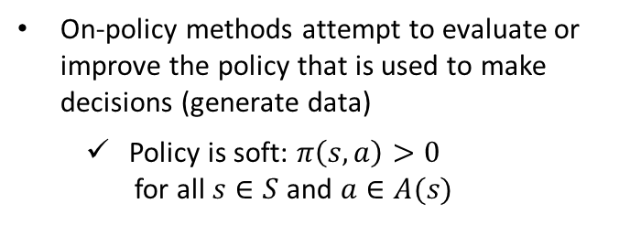
Monte Carlo Control
On policy algorithm
Off policy algorithm
On-policy methods attempt to evaluate or improve the policy that is used to make decisions (generate data)
Policy is soft: $π\left(s,a\right)>0$
for all $s∈S$ and $a∈A(s)$
Behavioral policy is used to generate behavior
Estimation policy is evaluated and improved
Estimation policy may be deterministic, while the behavior policy can continue to sample all possible actions

Slide 30






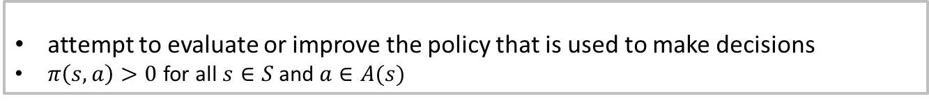







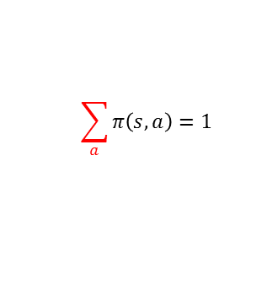


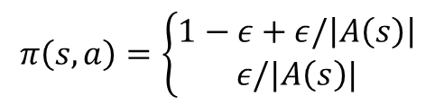



On-policy Monte Carlo Control
Key Idea : On-policy methods: Soft policies
attempt to evaluate or improve the policy that is used to make decisions
$π\left(s,a\right)>0$ for all $s∈S$ and $a∈A(s)$
$ε−soft$ policy
$ε−greedy$ policy
$π\left(s, a\right)≥\frac{ε}{\left|A\left(s\right)\right|}$ for all $a$
$$π\left(s, a\right)=\left\{\begin{aligned}1−ε+ε/\left|A\left(s\right)\right| \\ ε/|A\left(s\right)|\end{aligned}\right.$$
If $a=a∗$
If $a≠a∗$
$$\sum_{a}^{ }{π\left(s, a\right)=1}$$
Total probability = $\left(1−ε+\frac{ε}{\left|A\left(s\right)\right|}\right)1+\frac{ε}{\left|A\left(s\right)\right|}\left(\left|A\left(s\right)\right|−1\right)=1$
$$1−ε$$
$$\frac{ε}{5}$$
$$\frac{ε}{5}$$
$$a^{1}$$
$$a^{2}$$
$$a^{∗}$$
$$a^{4}$$
$$a^{5}$$
$$a^{1}$$
$$a^{2}$$
$$a^{∗}$$
$$a^{4}$$
$$a^{5}$$

Slide 31
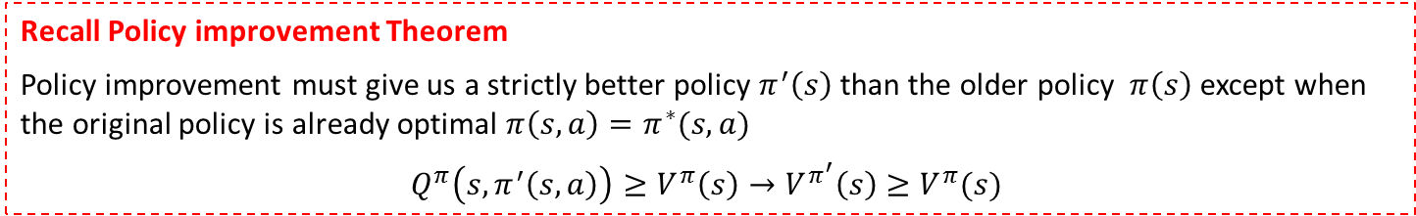

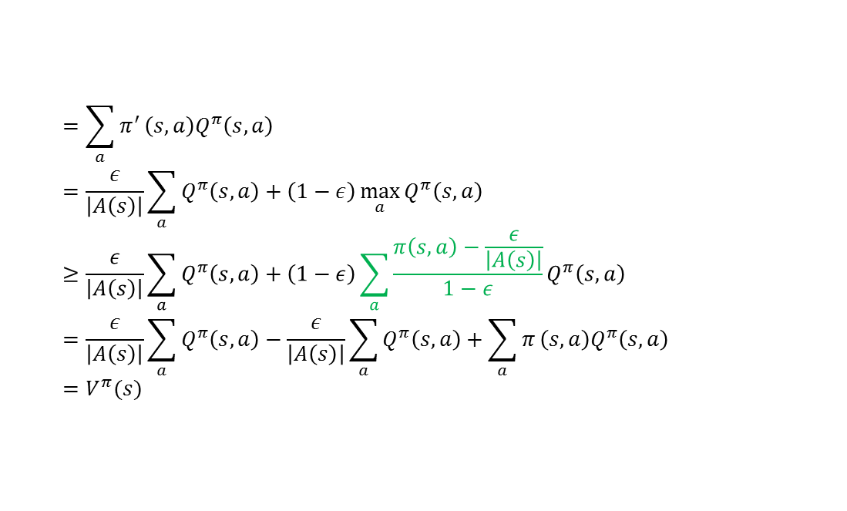

On-policy Monte Carlo Control
Any $ε−greedy$ policy $π^{′}$respect to $Q^{π}$ is an improvement over any $ε−soft$policy $π$
Let $π′$ be the $ε−greedy$ policy,
$$Q^{π}\left(s, π^{′}\left(s,a\right)\right)$$
$$=\sum_{a}^{ }{π^{′}}\left(s,a\right)Q^{π}\left(s, a\right)$$
$$=\frac{ε}{\left|A\left(s\right)\right|}\sum_{a}^{ }{Q^{π}\left(s, a\right)}+\left(1−ε\right)\max_{a}{Q^{π}\left(s, a\right)} ≥\frac{ε}{\left|A\left(s\right)\right|}\sum_{a}^{ }{Q^{π}\left(s, a\right)}+\left(1−ε\right)\sum_{a}^{ }{\frac{π\left(s,a\right)−\frac{ε}{\left|A\left(s\right)\right|}}{1−ε}}Q^{π}\left(s, a\right)$$
$$=\frac{ε}{\left|A\left(s\right)\right|}\sum_{a}^{ }{Q^{π}\left(s, a\right)}−\frac{ε}{\left|A\left(s\right)\right|}\sum_{a}^{ }{Q^{π}\left(s, a\right)}+\sum_{a}^{ }{π}\left(s,a\right)Q^{π}\left(s, a\right)$$
$$=V^{π}(s)$$
Recall Policy improvement Theorem
Policy improvement must give us a strictly better policy $π^{′}\left(s\right)$ than the older policy $π\left(s\right)$ except when the original policy is already optimal $π\left(s,a\right)=π^{∗}(s,a)$
$$Q^{π}\left(s,π^{′}\left(s,a\right)\right)≥V^{π}\left(s\right)→V^{π^{′}}\left(s\right)≥V^{π}(s)$$
Thus, by the policy improvement theorem, $π^{′}≥π$ (i.e., $V^{π^{′}}\left(s\right)≥V^{π}\left(s\right)$ for all $s∈S$)

Slide 32



On-policy Monte Carlo Control
Algorithm : $ε−soft$ On-Policy Monte Carlo Control
Initialize, for all $s∈𝒮, a∈𝒜(s)$
$Q\left(s, a\right)←$ arbitrary
$π←$ an arbitrary $ε−soft$ policy
$U\left(s, a\right)←$ empty list
Repeat forever:
Generate an episode using $π$
For each pair $\left(s,a\right)$ appearing in the episode:
$U$ $←$ utility following the first occurrence of $s,a$
Append $U$ to $U\left(s, a\right)$
$Q\left(s, a\right)←$ average($U\left(s, a\right)$)
(c) For each $s$ in the episode:
$$a^{∗}←\underset{a∈𝒜(s) }{argmax}{Q(s,a)}$$
For all$a∈𝒜(s)$
$$π\left(s, a\right)=\left\{\begin{aligned}1−ε+ε/\left|A\left(s\right)\right| \\ ε/|A\left(s\right)|\end{aligned}\right.$$
Policy evaluation
Policy improvement
If $a=a∗$
If $a≠a∗$

Slide 33
Monte Carlo control algorithm
Black Jack Example

Slide 34
Model-Free Monte Carlo Based Methods
How to estimate $V^{∗}(s)$ and $Q^{∗}(s,a)$
Monte Carlo method
Temporal Difference methods
Non-Bootstrap
Bootstrap
On-policy
On-policy
Monte Carlo Control
SARSA
How to
explore ?
Off-policy
Off-policy
Monte Carlo Control
Q-Learning
Episodic based
Single-data-point based

Slide 35
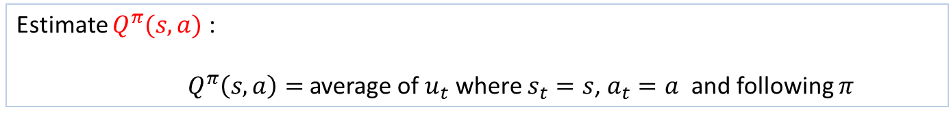
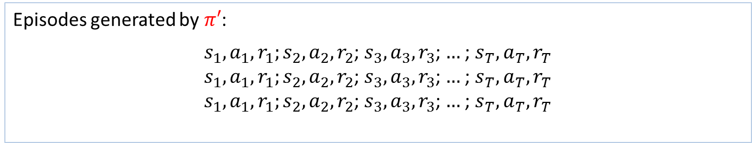
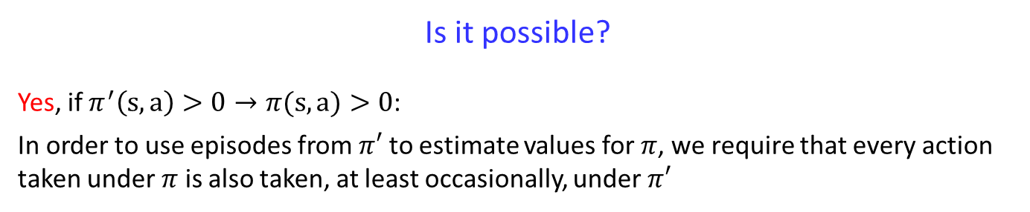


Off-policy Monte Carlo Control
Evaluate One Policy While Following Another
Episodes generated by $π′$:
$s_{1}, a_{1}, r_{1};s_{2}, a_{2}, r_{2}$; $s_{3}, a_{3}, r_{3}$; $…$; $s_{T}, a_{T}, r_{T}$
$s_{1}, a_{1}, r_{1};s_{2}, a_{2}, r_{2}$; $s_{3}, a_{3}, r_{3}$; $…$; $s_{T}, a_{T}, r_{T}$
$s_{1}, a_{1}, r_{1};s_{2}, a_{2}, r_{2}$; $s_{3}, a_{3}, r_{3}$; $…$; $s_{T}, a_{T}, r_{T}$
$s_{t}∈𝒮=\left\{s^{1},s^{2},s^{3}\right\}$,$a_{t}∈𝒜=\left\{a^{1},a^{2},a^{3}\right\}$
Episode 1:
Episode 2:
Episode 3:
$$⋮$$
Estimate $Q^{π}(s,a)$ :
$Q^{π}\left(s,a\right)=$ average of $u_{t}$ where $s_{t}=s$, $a_{t}=a$ and following $π$
Is it possible?
Yes, if $π^{′}\left(s,a\right)>0→π(s,a)>0$:
In order to use episodes from $π′$ to estimate values for $π$, we require that every action taken under $π$ is also taken, at least occasionally, under $π′$

Slide 36
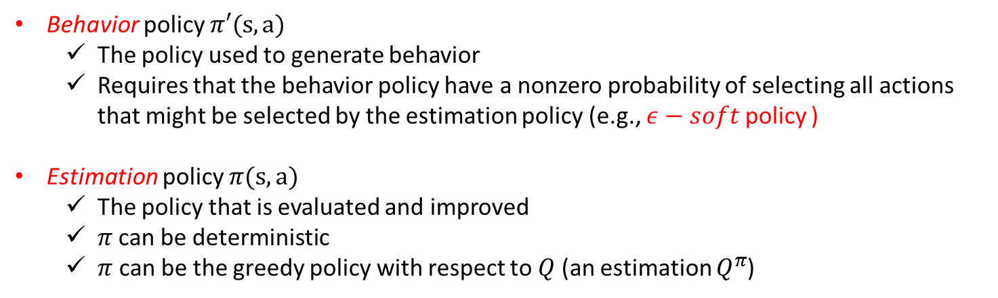
Off-policy Monte Carlo Control
Key Idea : Off-policy algorithm
Follows the behavior policy while learning about and improving the estimation policy
Behavior policy $π′(s,a)$
The policy used to generate behavior
Requires that the behavior policy have a nonzero probability of selecting all actions that might be selected by the estimation policy (e.g., $ε−soft$ policy )
Estimation policy $π(s,a)$
The policy that is evaluated and improved
$π$can be deterministic
$π$ can be the greedy policy with respect to $Q$ (an estimation $Q^{π}$)
Disadvantages
→ Learning can be slow

Slide 37











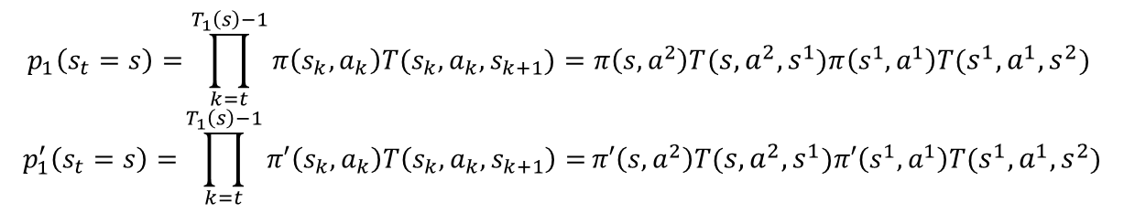








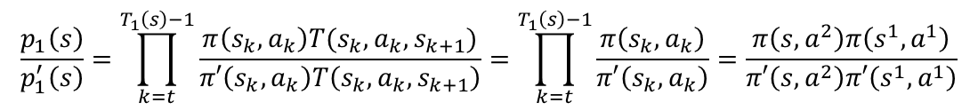















Off-policy Monte Carlo Control :Evaluate One Policy While Following Another
$$s_{t}$$
$$a_{t}$$
$$s_{t+1}$$
$$a_{t+1}$$
$$s_{t+2}$$
$$s^{1}$$
Episode $1$
$$s,a^{1}$$
$$s^{1}$$
$$a^{1}$$
$$s^{2}$$
$$s^{1},a^{1}$$
$$T(s^{1},a^{1},s^{2})$$
$$a^{1}$$
$$s^{2}$$
$$T(s,a^{2},s^{1})$$
$$s^{1}$$
$$a^{2}$$
$$s^{1},a^{2}$$
$$a^{2}$$
$$a^{3}$$
$$r\left(s^{1},a^{1},s^{2} \right)$$
$$s$$
$$s,a^{2}$$
$$r\left(s,a^{2},s^{2} \right)$$
$$s^{2}$$
$${ s}^{1},a^{3}$$
$$a^{3}$$
$$s^{1}$$
$$s,a^{3}$$
$$U_{1}^{π′}\left(s\right)=r\left(s,a^{2},s^{2} \right)+r\left(s^{1},a^{1},s^{2} \right)$$
$$s^{2}$$
$$p_{1}\left(s_{t}=s\right)=\prod_{k=t}^{T_{1}\left(s\right)−1}{π\left(s_{k},a_{k}\right)T(s_{k}, a_{k}, s_{k+1})}=π\left(s,a^{2}\right)T(s,a^{2},s^{1})π\left(s^{1},a^{1}\right)T(s^{1},a^{1},s^{2})$$
$$p_{1}^{′}\left(s_{t}=s\right)=\prod_{k=t}^{T_{1}\left(s\right)−1}{π′\left(s_{k},a_{k}\right)T\left(s_{k}, a_{k}, s_{k+1}\right)=}π′\left(s,a^{2}\right)T(s,a^{2},s^{1})π′\left(s^{1},a^{1}\right)T(s^{1},a^{1},s^{2})$$
$$\frac{p_{1}\left(s\right)}{p_{1}^{′}\left(s\right)}=\prod_{k=t}^{T_{1}\left(s\right)−1}{\frac{π\left(s_{k},a_{k}\right)T(s_{k}, a_{k}, s_{k+1})}{π′\left(s_{k},a_{k}\right)T\left(s_{k}, a_{k}, s_{k+1}\right)}}=\prod_{k=t}^{T_{1}\left(s\right)−1}{\frac{π\left(s_{k},a_{k}\right)}{π′\left(s_{k},a_{k}\right)}}=\frac{π\left(s,a^{2}\right)π\left(s^{1},a^{1}\right)}{π′\left(s,a^{2}\right)π′\left(s^{1},a^{1}\right)}$$

Slide 38



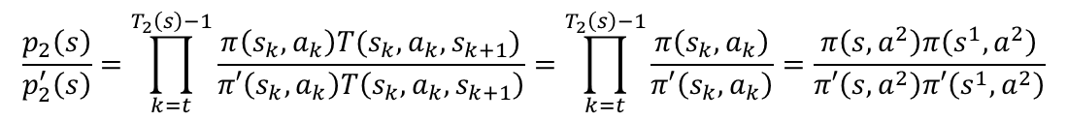




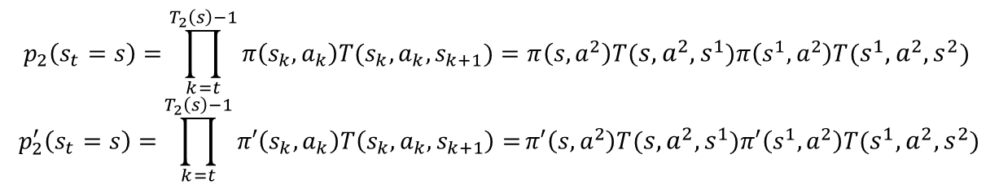




















Off-policy Monte Carlo Control :Evaluate One Policy While Following Another
$$s_{t}$$
$$a_{t}$$
$$s_{t+1}$$
$$a_{t+1}$$
$$s_{t+2}$$
$$s^{1}$$
Episode $2$
$$s,a^{1}$$
$$a^{1}$$
$$s^{2}$$
$$s^{1},a^{1}$$
$$a^{1}$$
$$s^{1}$$
$$T(s,a^{2},s^{1})$$
$$s^{1}$$
$$a^{2}$$
$$s^{1},a^{2}$$
$$T(s^{1},a^{2},s^{2})$$
$$s$$
$$a^{2}$$
$$s,a^{2}$$
$$a^{3}$$
$$r\left(s,a^{2},s^{2} \right)$$
$$s^{2}$$
$$s^{2}$$
$${ s}^{1},a^{3}$$
$$a^{3}$$
$$r\left(s^{1},a^{1},s^{2} \right)$$
$$s^{1}$$
$$s,a^{3}$$
$$U_{2}^{π^{′}}(s)=r\left(s,a^{2},s^{2} \right)+r\left(s^{1},a^{1},s^{2} \right)$$
$$s^{2}$$
$$p_{2}\left(s_{t}=s\right)=\prod_{k=t}^{T_{2}\left(s\right)−1}{π\left(s_{k},a_{k}\right)T(s_{k}, a_{k}, s_{k+1})}=π\left(s,a^{2}\right)T(s,a^{2},s^{1})π\left(s^{1},a^{2}\right)T(s^{1},a^{2},s^{2})$$
$$p_{2}^{′}\left(s_{t}=s\right)=\prod_{k=t}^{T_{2}\left(s\right)−1}{π′\left(s_{k},a_{k}\right)T\left(s_{k}, a_{k}, s_{k+1}\right)=}π′\left(s,a^{2}\right)T(s,a^{2},s^{1})π′\left(s^{1},a^{2}\right)T(s^{1},a^{2},s^{2})$$
$$\frac{p_{2}\left(s\right)}{p_{2}^{′}\left(s\right)}=\prod_{k=t}^{T_{2}\left(s\right)−1}{\frac{π\left(s_{k},a_{k}\right)T(s_{k}, a_{k}, s_{k+1})}{π′\left(s_{k},a_{k}\right)T\left(s_{k}, a_{k}, s_{k+1}\right)}}=\prod_{k=t}^{T_{2}\left(s\right)−1}{\frac{π\left(s_{k},a_{k}\right)}{π′\left(s_{k},a_{k}\right)}}=\frac{π\left(s,a^{2}\right)π\left(s^{1},a^{2}\right)}{π′\left(s,a^{2}\right)π′\left(s^{1},a^{2}\right)}$$

Slide 39








Off-policy Monte Carlo Control :Evaluate One Policy While Following Another
$$s_{t}$$
$$a_{t}$$
$$s_{t+1}$$
$$a_{t+1}$$
$$s_{t+2}$$
$$s^{1}$$
Episode$i$
$$s,a^{1}$$
$$s^{1}$$
$$a^{1}$$
$$s^{2}$$
$$s^{1},a^{1}$$
$$T(s^{1},a^{1},s^{2})$$
$$a^{1}$$
$$s^{2}$$
$$T(s,a^{2},s^{1})$$
$$s^{1}$$
$$a^{2}$$
$$s^{1},a^{2}$$
$$a^{2}$$
$$a^{3}$$
$$r\left(s^{1},a^{1},s^{2} \right)$$
$$s$$
$$s,a^{2}$$
$$r\left(s,a^{2},s^{2} \right)$$
$$s^{2}$$
$${ s}^{1},a^{3}$$
$$a^{3}$$
$$s^{1}$$
$$s,a^{3}$$
$$U_{i}^{π^{′}}(s)=r\left(s,a^{2},s^{2} \right)+r\left(s^{1},a^{1},s^{2} \right)$$
$$s^{2}$$
$$p_{i}\left(s_{t}=s\right)=\prod_{k=t}^{T_{i}\left(s\right)−1}{π\left(s_{k},a_{k}\right)T(s_{k}, a_{k}, s_{k+1})}=π\left(s,a^{2}\right)T(s,a^{2},s^{1})π\left(s^{1},a^{1}\right)T(s^{1},a^{1},s^{2})$$
$$p_{i}^{′}\left(s_{t}=s\right)=\prod_{k=t}^{T_{i}\left(s\right)−1}{π′\left(s_{k},a_{k}\right)T\left(s_{k}, a_{k}, s_{k+1}\right)=}π′\left(s,a^{2}\right)T(s,a^{2},s^{1})π′\left(s^{1},a^{1}\right)T(s^{1},a^{1},s^{2})$$
$$\frac{p_{i}\left(s\right)}{p_{i}^{′}\left(s\right)}=\prod_{k=t}^{T_{i}\left(s\right)−1}{\frac{π\left(s_{k},a_{k}\right)T(s_{k}, a_{k}, s_{k+1})}{π′\left(s_{k},a_{k}\right)T\left(s_{k}, a_{k}, s_{k+1}\right)}}=\prod_{k=t}^{T_{i}\left(s\right)−1}{\frac{π\left(s_{k},a_{k}\right)}{π′\left(s_{k},a_{k}\right)}}=\frac{π\left(s,a^{2}\right)π\left(s^{1},a^{1}\right)}{π′\left(s,a^{2}\right)π′\left(s^{1},a^{1}\right)}$$

Slide 40





Off-policy Monte Carlo Control :Evaluate One Policy While Following Another
Compute the value function $V^{π}\left(s\right)$ using the data generated by $π′$
with $s_{t}=s$
For $i=1:n_{s}$ ($n_{s}$ episodes)
$$p_{i}\left(s_{t}=s\right)=\prod_{k=t}^{T_{i}\left(s\right)−1}{π\left(s_{k},a_{k}\right)T(s_{k}, a_{k}, s_{k+1})}$$
$$p_{i}^{′}\left(s_{t}=s\right)=\prod_{k=t}^{T_{i}\left(s\right)−1}{π′\left(s_{k},a_{k}\right)T(s_{k}, a_{k}, s_{k+1})}$$
$$\frac{p_{i}\left(s_{t}\right)}{p_{i}^{′}\left(s_{t}\right)}=\prod_{k=t}^{T_{i}\left(s\right)−1}{\frac{π\left(s_{k},a_{k}\right)}{π′\left(s_{k},a_{k}\right)}}$$
$$U_{i}^{π′}(s)$$
The desired Monte Carlo estimate after observing $n_{s}$ utilities from state $s_{t}=s$ is then
$$V^{π}\left(s\right)=\frac{\sum_{i=1}^{n_{s}}{\frac{p_{i}\left(s\right)}{p_{i}^{′}\left(s\right)}}U_{i}^{π′}(s) }{\sum_{i=1}^{n_{s}}{\frac{p_{i}\left(s\right)}{p_{i}^{′}\left(s\right)}}}$$
To compute the weights $\frac{p_{i}\left(s\right)}{p_{i}^{′}\left(s\right)}$ and estimate the value, we only needs two policies $π\left(s,a\right)$ and $π′\left(s,a\right)$

Slide 41




Off-policy Monte Carlo Control :Evaluate One Policy While Following Another
Compute the value function $Q^{π}\left(s,a\right)$ using the data generated by $π′$
with $s_{t}=s$
For $i=1:n_{s}$ ($n_{s}$ episodes)
$$p_{i}\left(s_{t}=s,a_{t}=a\right)=\prod_{k=t}^{T_{i}\left(s\right)−1}{π\left(s_{k},a_{k}\right)T(s_{k}, a_{k}, s_{k+1})}$$
$$p_{i}^{′}\left(s_{t}=s,a_{t}=a\right)=\prod_{k=t}^{T_{i}\left(s\right)−1}{π′\left(s_{k},a_{k}\right)T(s_{k}, a_{k}, s_{k+1})}$$
$$\frac{p_{i}\left(s_{t}\right)}{p_{i}^{′}\left(s_{t}\right)}=\prod_{k=t}^{T_{i}\left(s\right)−1}{\frac{π\left(s_{k},a_{k}\right)}{π′\left(s_{k},a_{k}\right)}}$$
$$U_{i}^{π^{′}}(s,a)$$
The desired Monte Carlo estimate after observing $n_{s}$ utilities from state $s_{t}=s$ is then
$$Q^{π}\left(s,a\right)=\frac{\sum_{i=1}^{n_{s}}{\frac{p_{i}\left(s\right)}{p_{i}^{′}\left(s\right)}}U_{i}^{π^{′}}(s,a)}{\sum_{i=1}^{n_{s}}{\frac{p_{i}\left(s\right)}{p_{i}^{′}\left(s\right)}}}=\frac{\sum_{i=1}^{n_{s}}{\prod_{k=t}^{T_{i}\left(s\right)−1}{\frac{π\left(s_{k},a_{k}\right)}{π′\left(s_{k},a_{k}\right)}}}U_{i}^{π^{′}}(s,a)}{\sum_{i=1}^{n_{s}}{\prod_{k=t}^{T_{i}\left(s\right)−1}{\frac{π\left(s_{k},a_{k}\right)}{π′\left(s_{k},a_{k}\right)}}}}$$
To compute the weights $\frac{p_{i}\left(s\right)}{p_{i}^{′}\left(s\right)}$ and estimate the value, we only needs two policies $π\left(s,a\right)$ and $π′\left(s,a\right)$

Slide 42
Off-policy Monte Carlo Control
Key Idea : Off-policy algorithm
Follows the behavior policy while learning about and improving the estimation policy
Behavior policy $π′(s,a)$
The policy used to generate behavior
Requires that the behavior policy have a nonzero probability of selecting all actions that might be selected by the estimation policy (e.g., $ε−soft$ policy )
Estimation policy $π(s,a)$
The policy that is evaluated and improved
$π$can be deterministic
$π$ can be the greedy policy with respect to $Q$ (an estimation $Q^{π}$)
Disadvantages
→ Learning can be slow

Slide 43


Off-policy Monte Carlo Control
Algorithm : An off-policy Monte Carlo Control
Initialize, for all $s∈𝒮, a∈𝒜(s)$
$Q\left(s, a\right)←$ arbitrary
$N\left(s, a\right)←$ 0
$D\left(s, a\right)←$ 0
$π←$ arbitrary deterministic policy
Repeat forever:
Select a policy $π′$ and use it to generate an episode:
$$s_{0}, a_{0}, r_{1}, s_{1}, a_{1},r_{2},…,s_{T−1}, a_{T−1}, r_{T}., s_{T}$$
Find $τ⟵$the latest time at which $a_{τ}≠π(s_{τ})$
For each pair $(s$, $a)$ appearing in the episodes at time $τ$ or later
$t$ $←$ the time of first occurrence of $(s, a)$ such that $t≥τ$
$w←\prod_{k=t+1}^{T−1}{\frac{1}{π′\left(s_{k},a_{k}\right)}}$
$Q\left(s, a\right)←$ $Q\left(s, a\right)+wU_{t}$
$$D\left(s, a\right)←D\left(s, a\right)+w$$
$$Q\left(s, a\right)←\frac{N\left(s,a\right)}{D(s,a)}$$
(c) For each $s$ in the episode:
$$π\left(s\right)←\underset{a∈𝒜(s) }{argmax}{Q(s,a)}$$
1
$$Q^{π}\left(s,a\right)=\frac{\sum_{i=1}^{n_{s}}{\prod_{k=t}^{T_{i}\left(s\right)−1}{\frac{π\left(s_{k},a_{k}\right)}{π′\left(s_{k},a_{k}\right)}}}U_{i}^{π^{′}}(s,a)}{\sum_{i=1}^{n_{s}}{\prod_{k=t}^{T_{i}\left(s\right)−1}{\frac{π\left(s_{k},a_{k}\right)}{π′\left(s_{k},a_{k}\right)}}}}$$

Slide 44
Summary
The Monte Carlo methods learn value functions and optimal policies from experience in the form of sample episodes
Advantages are:
Can be used to learn optimal behavior directly from interaction with the environment with no models of environment dynamics
Can be used with simulation or sample models
It is efficient to focus Monte Carlo methods on a small subset of the states
Less harmed by violations of the Markov property. This is because they do not update their value estimates on the basis of the value estimates of successor states (do not use bootstrap)

